Slide 1
JAC444 - Lecture 6
Java Input / Output
Segment 1- Basics
Updated By: Mahboob Ali

Slide 2
Objectives
Upon completion of this lecture, you should be able to:
Examine Input / Output classes in Java
Create and Use I/O Streams in Java
Distinguish Byte, Character, and Buffered Stream
Design and Develop File I/O programs

Slide 3
Input / Output
In this lesson you will be learning about:
Types of Input / Output Stream
Typical use of IO Streams
Character and Byte Streams.

Slide 4
Java can read data from the Internet.
What does this data look like to a Java program?
Internet data looks like an I/O stream.

Slide 5
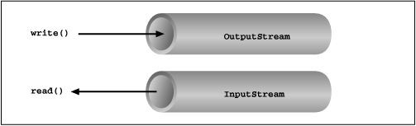

Reading / Writing Data
Reading Writing
Open a stream
while more information read information
close the stream
open a stream
while more information write information
close the stream

Slide 6
Java I/O
Java I/O (Input and Output) is used to process the input and produce the output.
Java uses the concept of stream to make I/O operation fast.
The java.io package contains all the classes required for input and output operations.

Slide 7
I/O Package
The package java.io contains the classes that handle fundamental input and output operations in Java.
The I/O classes can be grouped as follows:
Classes for reading input from a stream of data.
Classes for writing output to a stream of data.
Classes that manipulate files on the local filesystem.
Classes that handle object serialization.

Slide 8
Stream
A stream is a sequence of data. In Java a stream is composed of bytes.
It's called a stream because it is like a stream of water that continues to flow.
Streams support many different kinds of data, including simple bytes,
primitive data types, localized characters, and objects.
In java, 3 streams are created for us automatically also called Standard Streams.
System.out: standard output stream
System.in: standard input stream
System.err: standard error stream
(Out stream) System.out.println(“Some Message”);
(Error Stream) System.err.println(“Error message”);
(In Stream)
int i=System.in.read();//returns ASCII code of 1st character
System.out.println((char)i);//will print the character

Slide 9
Byte Stream
Programs use byte streams to perform input and output of 8-bit bytes.
All byte stream classes are descended from InputStream and OutputStream.
There are many byte stream classes.
Most frequently used ones are FileInputStream and FileOutputStream.
The drawback to these byte streams is that they do not always handle
Unicode characters correctly.
Byte streams should only be used for the most primitive I/O.
Byte streams are used to read/write raw bytes serially from/to an
external device.

Slide 10
Character Stream
The Java platform stores character values using Unicode conventions.
Character stream I/O automatically translates this internal format to and from
the local character set.
The local character set is usually an 8-bit superset of ASCII.
Input and output done with stream classes automatically translates to and
from the local character set.
The Reader class is the superclass of all the Java 1.1 character input streams,
while Writer is the superclass of all character output streams.
Character-based I/O is used for processing texts.

Slide 11
Byte Stream vs Character Stream
Designed to Deal with
“Raw Data”
Designed to deal with
“Character Data”
Byte by Byte (1 Byte -- 8-bits)
Character by Character
(1 char – 16 bits)
Does not always handle Unicode correctly
Coder responsibility to convert bytes to character
Handle Unicode appropriately
Which one is more efficient?
Note: Binary I/O does not involve encoding or decoding and is more efficient then text I/O.

Slide 12
OutputStream VS InputStream
OutputStream
Java application uses an output stream to write data to a destination, it may be a file,
an array, peripheral device or socket.
InputStream
Java application uses an input stream to read data from a source, it may be a file,
an array, peripheral device or socket.

Slide 13
InputStream class
It is the super class of all classes representing an Input stream of bytes Java 1.0.
Method | Description
+ read(): int | Reads the next byte of data from the input stream. The value byte is returned as an int value in the range 0 to 255. If no byte is available because the end of the stream has been reached, the value –1 is returned.
+ read(b: byte[]): int | Reads up to b.length bytes into array b from the input stream and returns the actual number of bytes read. Returns –1 at the end of the stream.
+ read(b: byte[], off: int, len: int): int | Reads bytes from the input stream and stores them in b[off], b[off+1], . . ., b[off+len-1]. The actual number of bytes read is returned. Returns –1 at the end of the stream.
+ available() : int | Returns an estimate of the number of bytes that can be read from the input stream.
+ close() : void | Closes this input stream and releases any system resources occupied by it.
+ skip(n: long): long | Skips over and discards n bytes of data from this input stream. The actual number of bytes skipped is returned

Slide 14
OutputStream class
It is the super class of all classes representing an output stream of bytes Java 1.0.
Method | Description
+ write(int b) : void | Writes the specified byte to this output stream. The parameter b is an int value. (byte)b is written to the output stream.
+ write(b: byte[]): void | Writes b[off], b[off+1],. . ., b[off+len-1] into the output stream.
+ write(b: byte[], off: int, len: int): void | Writes all the bytes in array b to the output stream.
+ close(): void | Closes this output stream and releases any system resources occupied by it.
+ flush(): void | Flushes this output stream and forces any buffered output bytes to be written out.

Slide 15
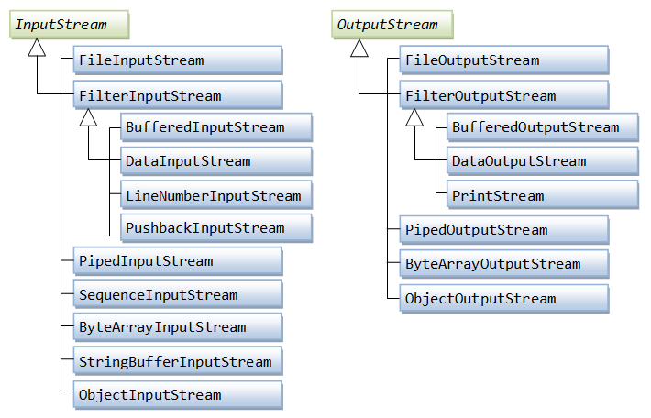

Slide 16
FileInputStream Class
FileInputStream is for writing bytes from files.
All the methods in this class is inherited from InputStream.
FileInputStream does not introduce new methods. To construct a FileInputStream, use
the constructors shown below.
A java.io.FileNotFoundException will occur if you attempt to create a FileInputStream
with a nonexistent file.
Java.io.FileInputStream
+FileInputStream(file: File)
+FileInputStream(filename: String)
Creates a FileInputStream from a File object.
Creates a FileInputStream from a file name.

Slide 17
FileInputStream Class
FileOutputStream is for reading bytes from files.
All the methods in this class is inherited from OutputStream.
FileOutputStream does not introduce new methods.
To construct a FileOutputStream, use the constructors shown below.
If the file does not exist, a new file will be created.
If the file already exists, the first two constructors will delete the current content of the file.
To retain the current content and append new data into the file, use the last two
constructors and pass true to the append parameter.
Java.io.FileOutputStream
+FileOutputStream(file: File)
+FileOutputStream(filename: String)
+FileOutputStream(file: File, append: boolean)
+FileOutputStream(filename: String, append: boolean)
Creates a FileOutputStream from a File object.
Creates a FileOutputStream from a file name.
If append is true, data are appended to the existing file.
If append is true, data are appended to the existing file.

Slide 18
import java.io.*;
public class TestFileStream {
public static void main(String[] args) throws IOException {
try (
// Create an output stream to the file
FileOutputStream output = new FileOutputStream("temp.dat");
) {
// Output values to the file
for (int i = 1; i <= 10; i++)
output.write(i);
}
try (
// Create an input stream for the file
FileInputStream input = new FileInputStream("temp.dat");
) {
// Read values from the file
int value;
while ((value = input.read()) != -1)
System.out.print(value + " ");
}
}
}
The program uses the try-with-resources to declare and create input and output streams
so that they will be automatically closed after they are used. JDK – 7 (AutoCloseable Interface)

Slide 19
BufferedInputStream/ BufferedOutputStream
The read()/write() method in InputStream/OutputStream are designed to read/write
a single byte of data on each call.
Overall inefficient, as each call is handled by the underlying operating system (which may
trigger a disk access, or other expensive operations).
Buffering, which reads/writes a block of bytes from the external device into/from a
memory buffer in a single I/O operation, is commonly applied to speed up the I/O.
FileInputStream/FileOutputStream are not buffered.
It is often chained to a BufferedInputStream or BufferedOutputStream, which provides
the buffering.
To chain the streams together, simply pass an instance of one stream into the constructor of
another stream. For example, the following codes chain a FileInputStream to a
BufferedInputStream, and finally, a DataInputStream.

Slide 20
Copy file byte-by-byte: No Buffering
import java.io.*;
public class FileCopyNoBuffer { // Pre-JDK 7
public static void main(String[] args) {
String inFileStr = "test-in.jpg";
String outFileStr = "test-out.jpg";
FileInputStream in = null;
FileOutputStream out = null;
long startTime, elapsedTime; // for speed benchmarking
// Print file length
File fileIn = new File(inFileStr);
System.out.println("File size is " + fileIn.length() + " bytes");
try {
in = new FileInputStream(inFileStr);
out = new FileOutputStream(outFileStr);
startTime = System.nanoTime();
int byteRead;
// Read a raw byte, returns an int of 0 to 255.
while ((byteRead = in.read()) != -1) {
// Write the least-significant byte of int, drop the upper 3 bytes
out.write(byteRead); }

Slide 21
elapsedTime = System.nanoTime() - startTime;
System.out.println("Elapsed Time is " + (elapsedTime / 1000000.0) + " msec");
} catch (IOException ex) { ex.printStackTrace(); }
finally { // always close the I/O streams
try {
if (in != null)
in.close();
if (out != null)
out.close();
} catch (IOException ex) { ex.printStackTrace();
}
}
}
}
Output:
File size is 417455 bytes
Elapsed Time is 3781.500581 msec

Slide 22
Copy File: Programmer Managed Buffer
import java.io.*;
public class FileCopyUserBuffer {
public static void main(String[] args) {
String inFileStr = "test-in.jpg";
String outFileStr = "test-out.jpg";
long startTime, elapsedTime; // for speed benchmarking
// Check file length File
File fileIn = new File(inFileStr);
System.out.println("File size is " + fileIn.length() + " bytes");
// "try-with-resources" automatically closes all opened resources.
try (FileInputStream in = new FileInputStream(inFileStr);
FileOutputStream out = new FileOutputStream(outFileStr)) {
startTime = System.nanoTime();
byte[] byteBuf = new byte[4096]; // 4K byte-buffer
int numBytesRead;
while ((numBytesRead = in.read(byteBuf)) != -1) {
out.write(byteBuf, 0, numBytesRead); }
elapsedTime = System.nanoTime() - startTime;
System.out.println("Elapsed Time is " + (elapsedTime / 1000000.0) + " msec");
} catch (IOException ex) { ex.printStackTrace(); }
}
}

Slide 23
Copy: Various Buffer Sizes
Observation in Output
Output:
File size is 26246026 bytes [26 MB]
1KB: 573.54msec
2KB: 316.43msec
4KB: 178.47msec
8KB: 116.32msec
16KB: 85.61msec
32KB: 65.92msec
64KB: 57.81msec
256KB: 63.38msec
1024KB: 98.87msec
import java.io.*;
public class FileCopyUserBuffer {
public static void main(String[] args) {
String inFileStr = "test-in.jpg";
String outFileStr = "test-out.jpg";
long startTime, elapsedTime; // for speed benchmarking
// Check file length File
File fileIn = new File(inFileStr);
System.out.println("File size is " + fileIn.length() + " bytes");
int[] bufSizeKB = {1, 2, 4, 8, 16, 32, 64, 256, 1024}; // in KB
int bufSize; // in bytes
for (int run = 0; run < bufSizeKB.length; ++run) {
bufSize = bufSizeKB[run] * 1024;
try (FileInputStream in = new FileInputStream(inFileStr);
FileOutputStream out = new FileOutputStream(outFileStr)) {
startTime = System.nanoTime();
byte[] byteBuf = new byte[bufSize]; int numBytesRead;
while ((numBytesRead = in.read(byteBuf)) != -1) {
out.write(byteBuf, 0, numBytesRead); }
elapsedTime = System.nanoTime() - startTime;
System.out.printf("%4dKB: %6.2fmsec%n", bufSizeKB[run], (elapsedTime / 1000000.0));
} catch (IOException ex) { ex.printStackTrace(); }
}
}
Increasing buffer size helps only up to a certain point.

Slide 24
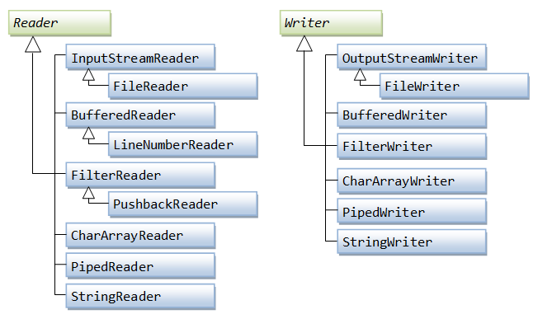
Character Based I/O

Slide 25
Reader & Writer
The Java Reader class (java.io.Reader) is the base class for all Reader subclasses in the
Java IO.
A Reader is like an InputStream except that it is character based rather than byte based.
A Java Reader is intended for reading text, whereas an InputStream is intended for reading
raw bytes.
The Reader class is capable of decoding bytes into characters.
Java IO contains a lot of Reader subclasses. InputStreamReader, CharArrayReader,
FileReader etc.
The Java Writer class (java.io.Writer) is the base class for all Writer subclasses in the Java IO.
A Writer is like an OutputStream except that it is character based rather than byte based.
A Writer is intended for writing text, whereas an OutputStream is intended for writing
raw bytes.
Some of subclasses of Writer include OutputStreamWriter, CharArrayWriter, FileWriter etc.

Slide 26
FileWriter Class
Java FileWriter class is used to write character-oriented data to a file.
It is character-oriented class which is used for file handling in java.
Unlike FileOutputStream class, you don't need to convert string into byte array because
it provides method to write string directly.
Method | Description
FileWriter(String file) | Creates a new file. It gets file name in string.
FileWriter(File file) | Creates a new file. It gets file name in File object.
void write(String text) | It is used to write the string into FileWriter.
void write(char c) | It is used to write the char into FileWriter.
void write(char[] c) | It is used to write char array into FileWriter.
void flush() | It is used to flushes the data of FileWriter.
void close() | It is used to close the FileWriter.

Slide 27
import java.io.FileWriter;
public class FileWriterExample {
public static void main(String args[]){
try{
FileWriter fw=new FileWriter("D:\\testout.txt");
fw.write("Welcome to java Class.");
fw.close();
}catch(Exception e){System.out.println(e);}
System.out.println("Success...");
}
}
\r\n

Slide 28
FileReader Class
Java FileReader class is used to read data from the file.
It returns data in byte format like FileInputStream class.
It is character-oriented class which is used for file handling in java.
Method | Description
FileReader(String file) | It gets filename in string. It opens the given file in read mode. If file doesn't exist, it throws FileNotFoundException.
FileReader(File file) | It gets filename in file instance. It opens the given file in read mode. If file doesn't exist, it throws FileNotFoundException.
int read() | It is used to return a character in ASCII form. It returns -1 at the end of file.
void close() | It is used to return a character in ASCII form. It returns -1 at the end of file.

Slide 29
import java.io.FileReader;
public class FileReaderExample {
public static void main(String args[])throws Exception{
FileReader fr=new FileReader("D:\\testout.txt");
int i;
while((i=fr.read())!=-1)
System.out.print((char)i);
fr.close();
}
}

Slide 30
BufferedWriter Class
Java BufferedWriter class is used to provide buffering for Writer instances.
Makes the performance fast.
Inherits Writer class.
The buffering characters are used for providing the efficient writing of single arrays, characters, and strings.
Method | Description
BufferedWriter(Writer wrt) | It is used to create a buffered character output stream that uses the default size for an output buffer.
BufferedWriter(Writer wrt, int size) | It is used to create a buffered character output stream that uses the specified size for an output buffer.
void newLine() | It is used to add a new line by writing a line separator.
void write(int c) | It is used to write a single character.
void write(char[] cbuf, int off, int len) | It is used to write a portion of an array of characters.
void write(String s, int off, int len) | It is used to write a portion of a string.
void flush() | It is used to flushes the input stream.
void close() | It is used to closes the input stream.

Slide 31
import java.io.*;
public class BufferedWriterExample {
public static void main(String[] args) throws Exception {
FileWriter writer = new FileWriter("D:\\testout.txt");
BufferedWriter buffer = new BufferedWriter(writer);
buffer.write("Welcome to java.");
buffer.close();
System.out.println("Success");
}
}

Slide 32
BufferedReader Class
Java BufferedReader class is used to read the text from a character-based input stream.
It can be used to read data line by line by readLine() method.
It makes the performance fast.
It inherits Reader class.
Method | Description
BufferedReader(Reader rd) | It is used to create a buffered character input stream that uses the default size for an input buffer.
BufferedReader(Reader rd, int size) | It is used to create a buffered character input stream that uses the specified size for an input buffer.
int read() | It is used for reading a single character.
int read(char[] cbuf, int off, int len) | It is used for reading characters into a portion of an array.
String readLine() | It is used for reading a line of text.
boolean ready() | It is used to test whether the input stream is ready to be read.
long skip(long n) | It repositions the stream at a position the mark method was last called on this input stream.
void close() | It closes the input stream and releases any of the system resources associated with the stream.

Slide 33
import java.io.*;
public class BufferedReaderExample{
public static void main(String[] args)throws Exception{
FileReader fr = new FileReader("D:\\textout.txt");
BufferedReader bf = new BufferedReader(fr);
int i;
while((i=bf.read())!=-1){
System.out.print((char)i);
}
bf.close();
fr.close();
}
}

Slide 34
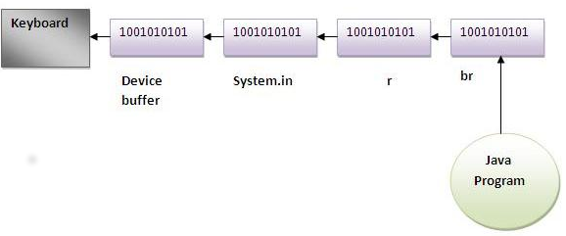
Combination: InputStreamReader and BufferedReader
import java.io.*;
public class BufferedReaderExample1{
public static void main(String args[])throws Exception{
InputStreamReader r=new InputStreamReader(System.in);
BufferedReader br=new BufferedReader(r);
System.out.println("Enter your name");
String name=br.readLine();
System.out.println("Welcome "+name);
}
}

Slide 35
Combination: InputStreamReader and BufferedReader
import java.io.*;
public class BufferedReaderExample{
public static void main(String args[])throws Exception{
InputStreamReader r=new InputStreamReader(System.in);
BufferedReader br=new BufferedReader(r);
String name="";
while(!name.equals("stop")){
System.out.println("Enter data: ");
name=br.readLine();
System.out.println("data is: "+name);
}
br.close();
r.close();
}
}

